Slide 1
Figure 3-1

Slide 2

Model Choice
Customization
Knowledge Base
Agents
Model Evaluation
Guardrails

Slide 3
Figure 3-2

Slide 4
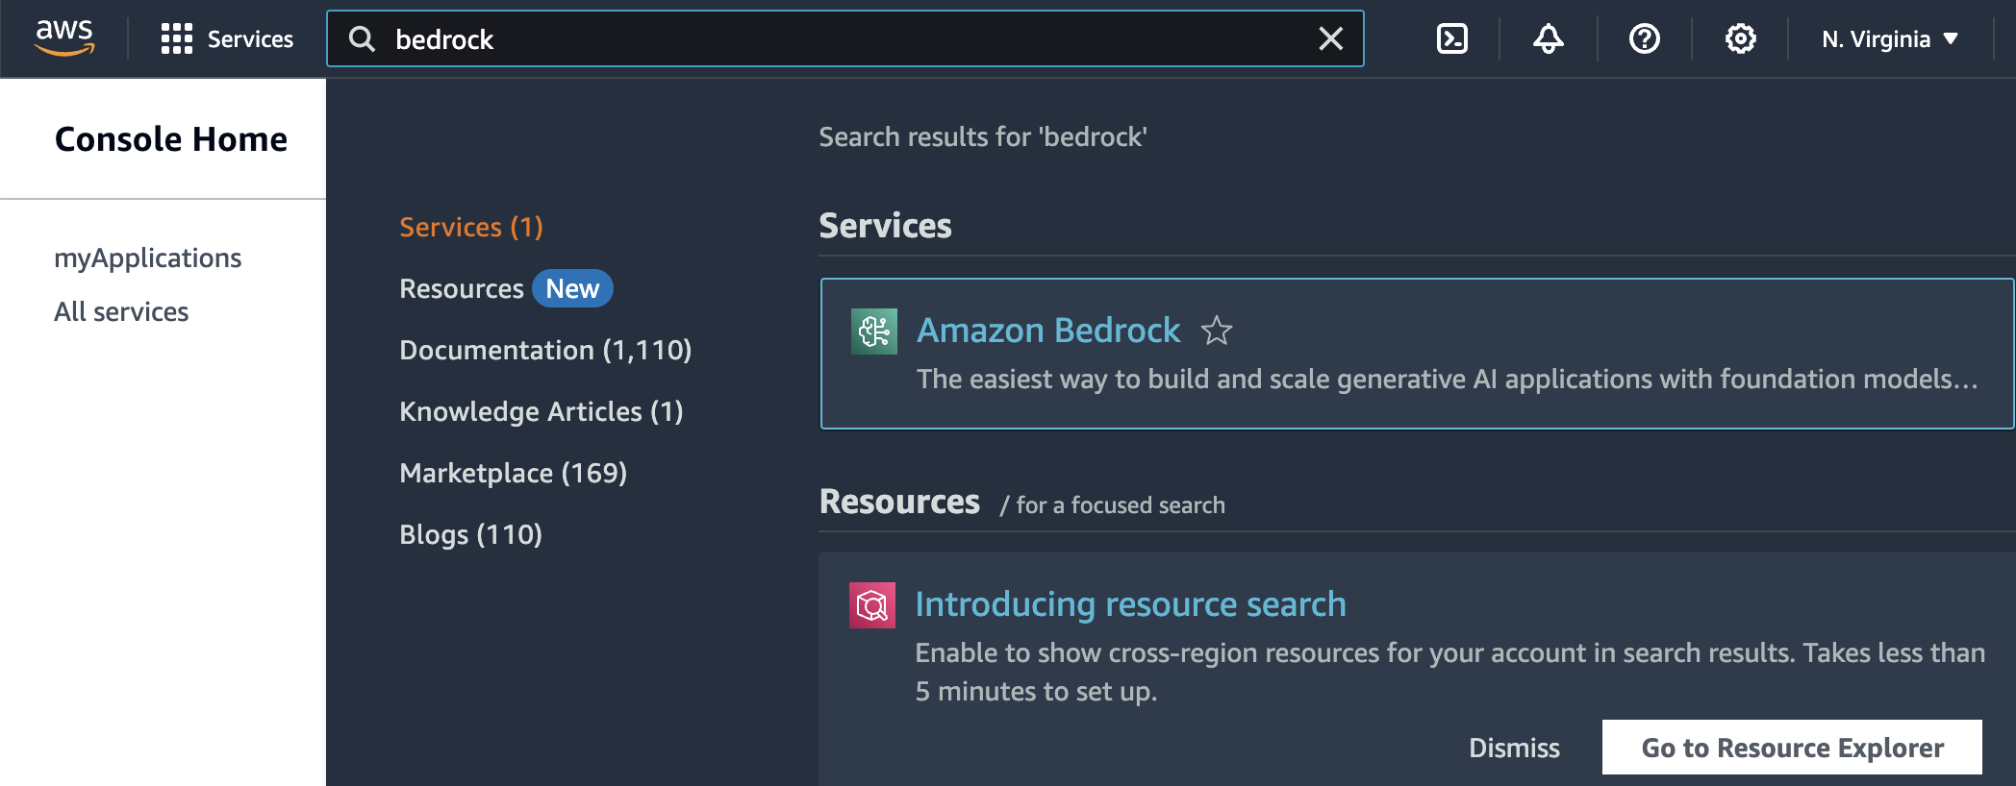

Slide 5
Figure 3-3a

Slide 6
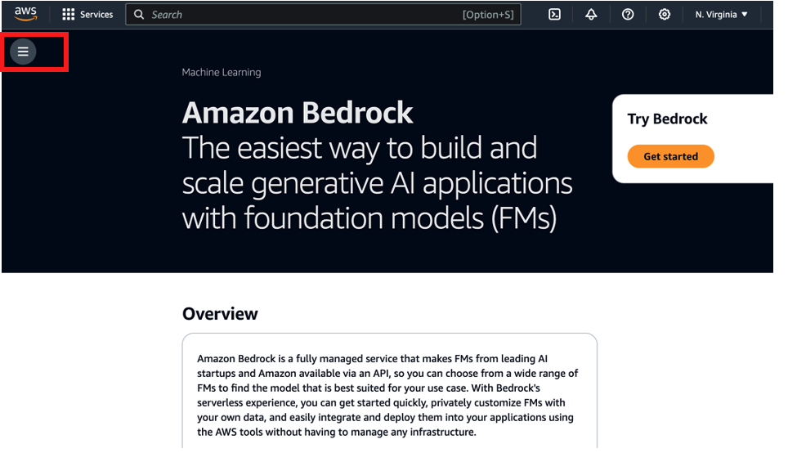

Slide 7
Figure 3-3b

Slide 8
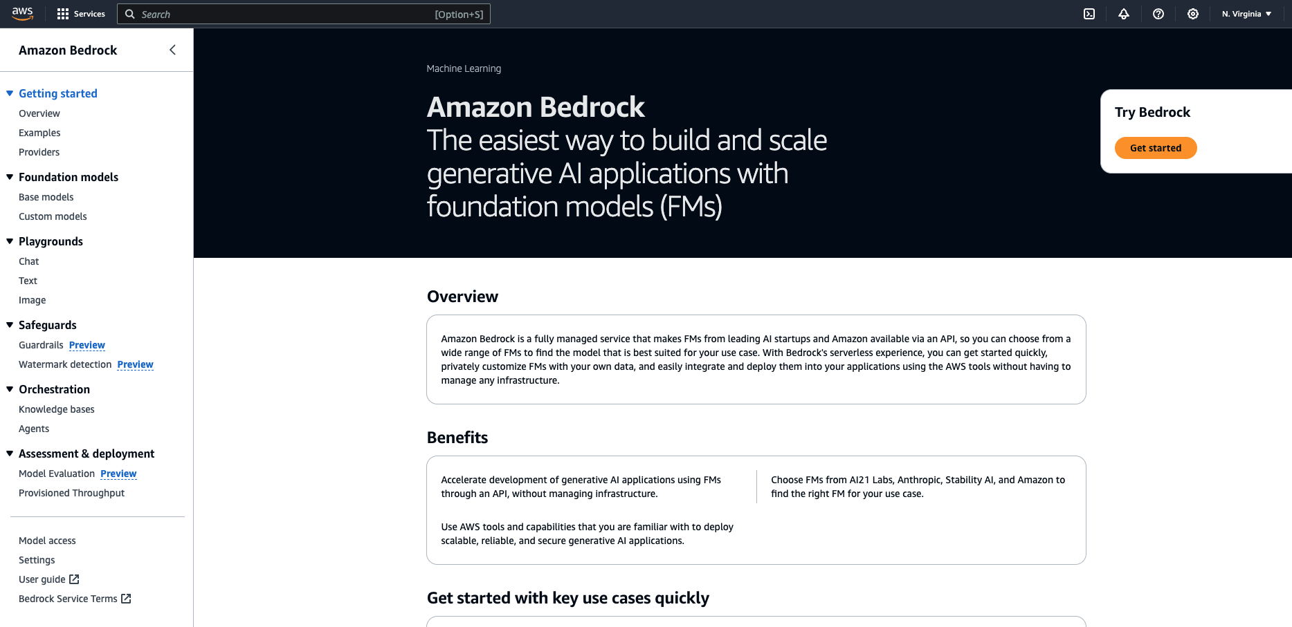

Slide 9
Figure 3-4

Slide 10
AI21labs
amazon
ANTHROP\C
cohere
Meta
Mistral AI
Text
Text
Text
Text
Text
Text
Jurassic family
Jumbo family
Titan family
Command family
Llama family
Mistral family
stability.ai
Image
Image
Titan Image family
Embeddings
Titan Embeddings family
Titan Multimodal Embeddings family
Claude family
Embeddings
Embed English
Embed Multilingual
STABLE DIFFUSION family

Slide 11
Figure 3-5

Slide 12
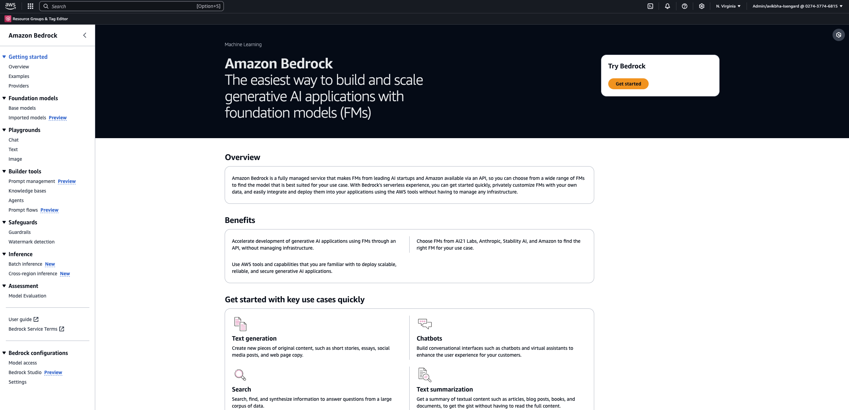









Slide 14
Figure 3-6

Slide 15
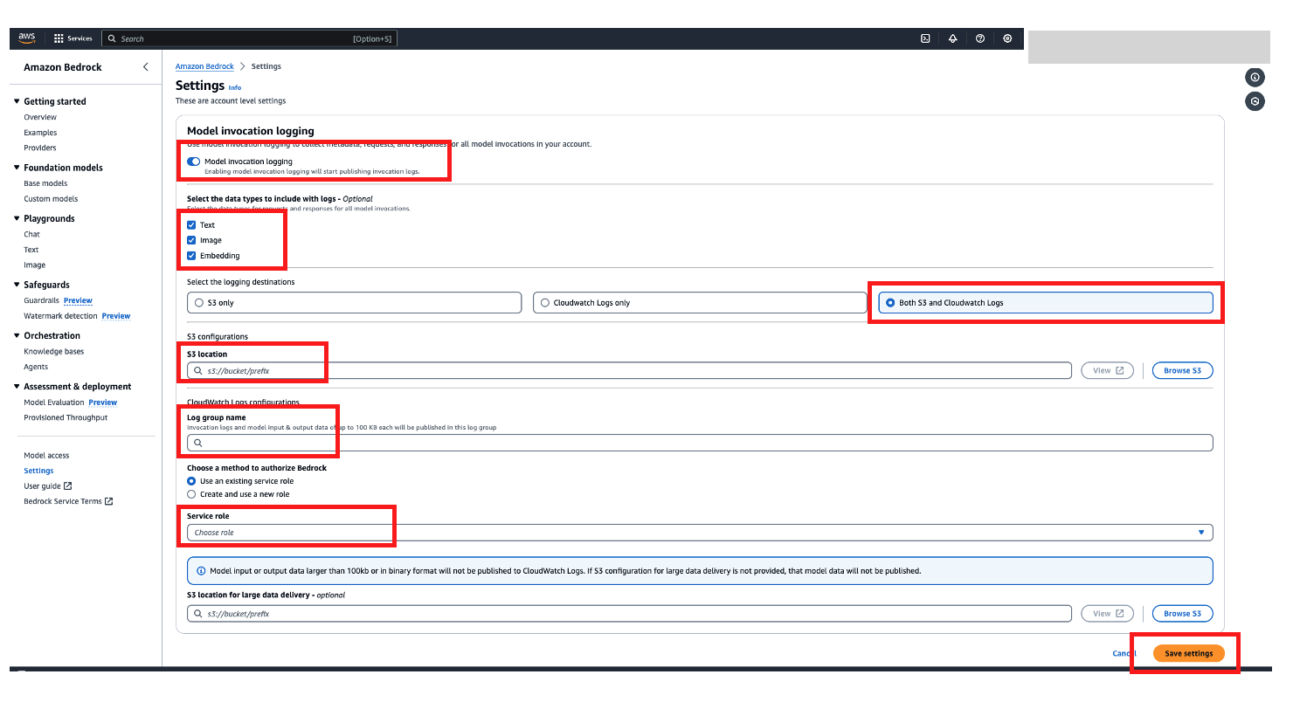

Slide 16
Figure 3-7

Slide 17
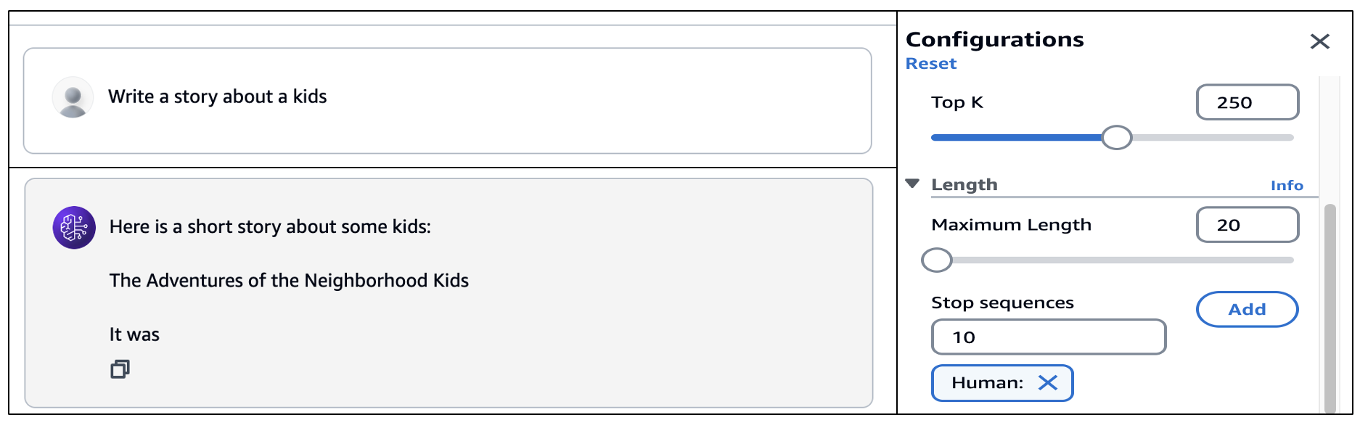

Slide 18
Figure 3-8

Slide 19
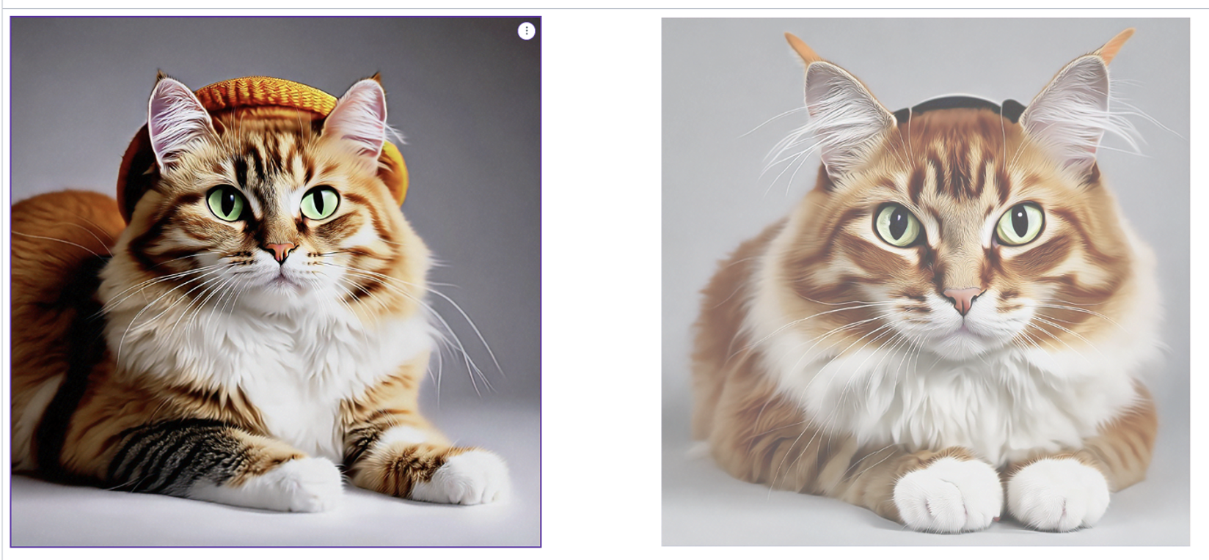
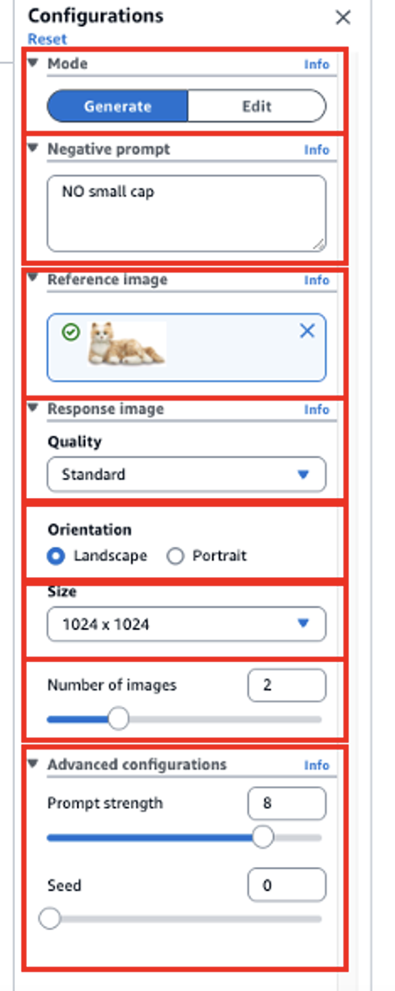
Prompt (Generate an image of cat with a big hat. )
Image Playground

Slide 20
